Slide 1
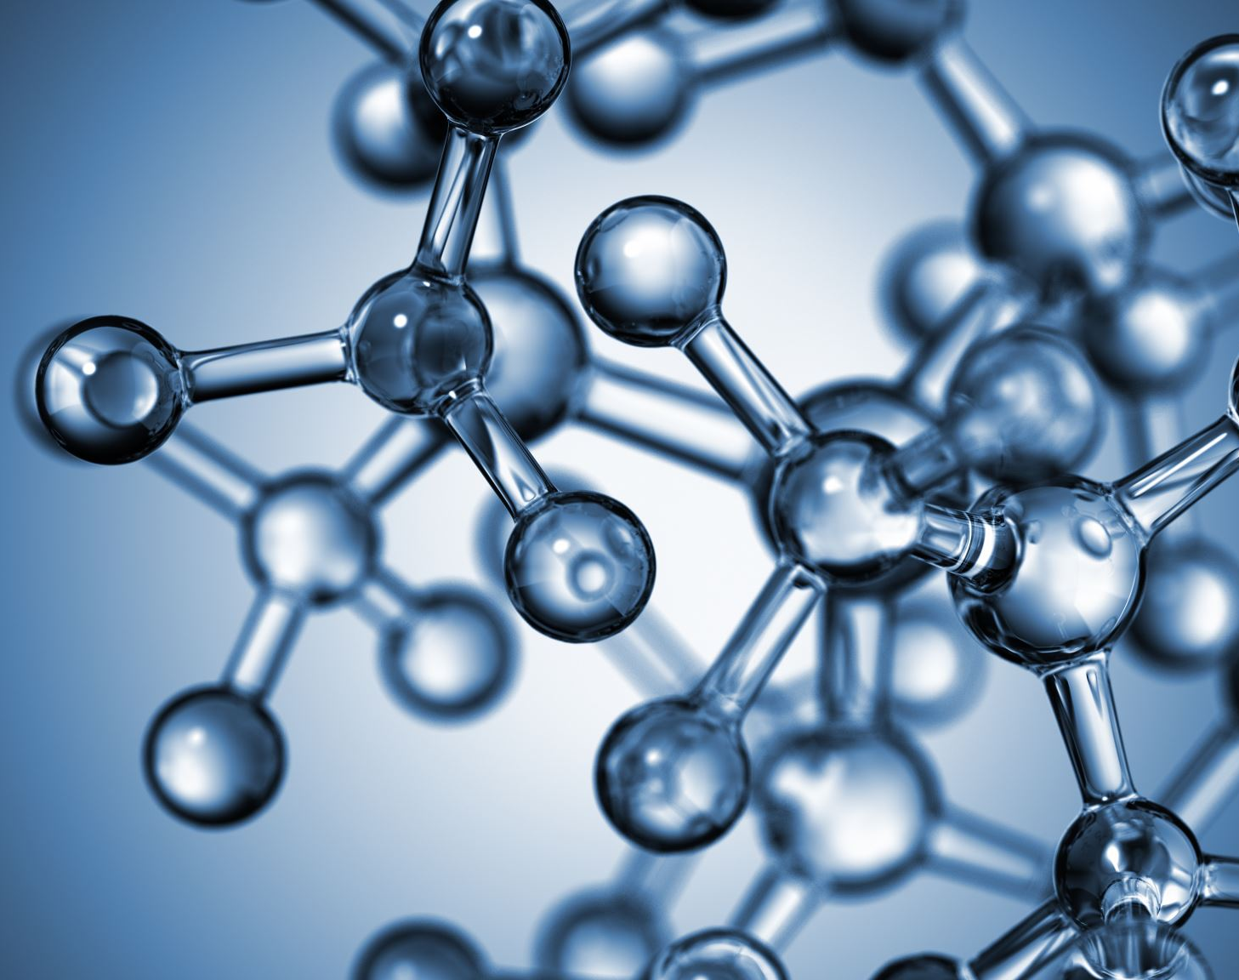
Simulating Replication by Handhold Mediated Strand Displacement using oxDNA
Nika Afshar Shafaei

Slide 2
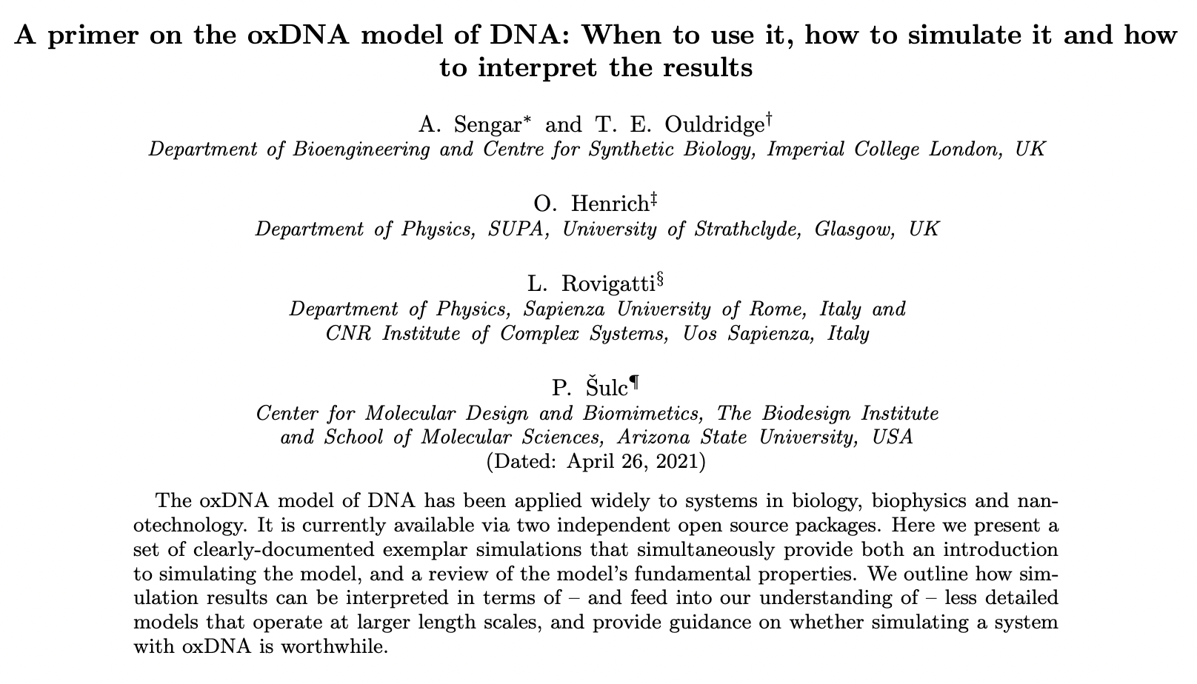
Preliminary Step: Follow in Aditya’s Footsteps

Slide 3
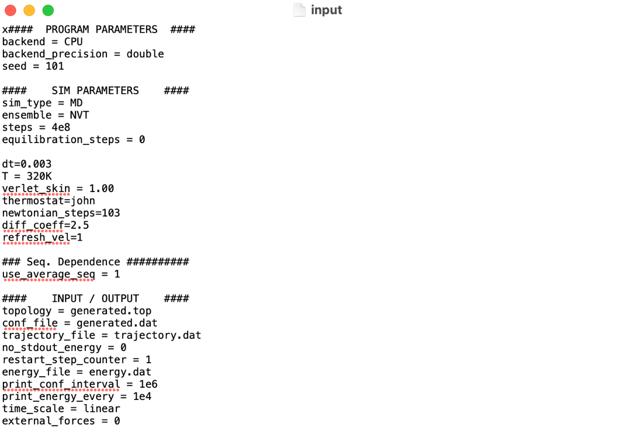
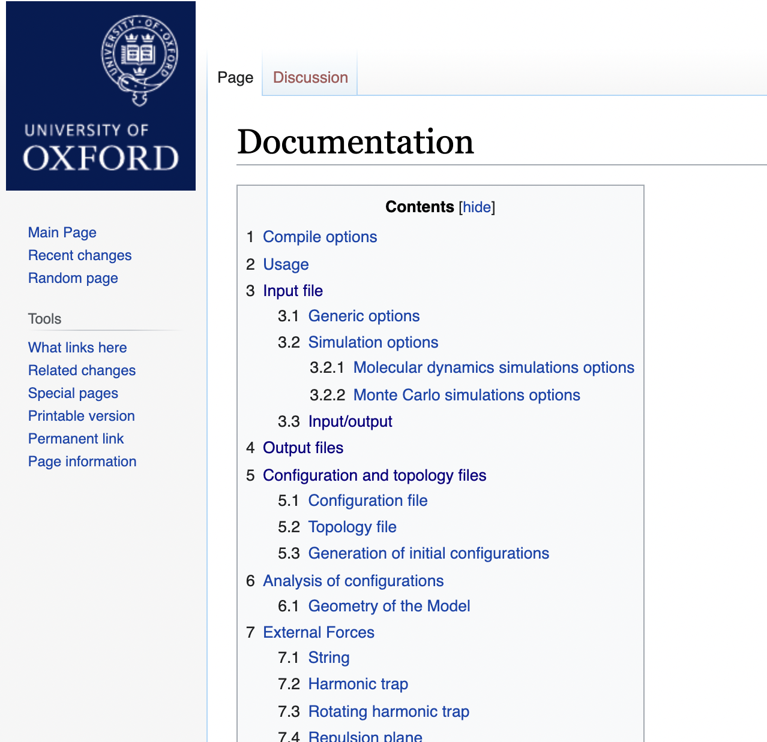
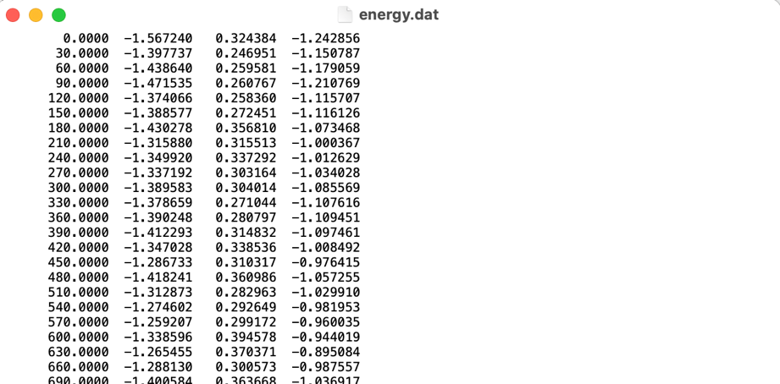
Step 1: Learn to use oxDNA

Slide 4
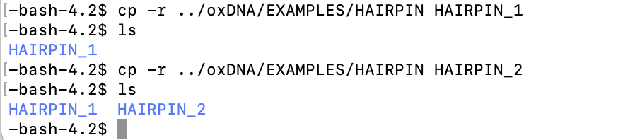
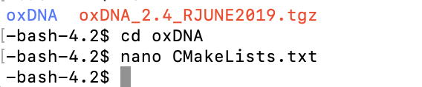
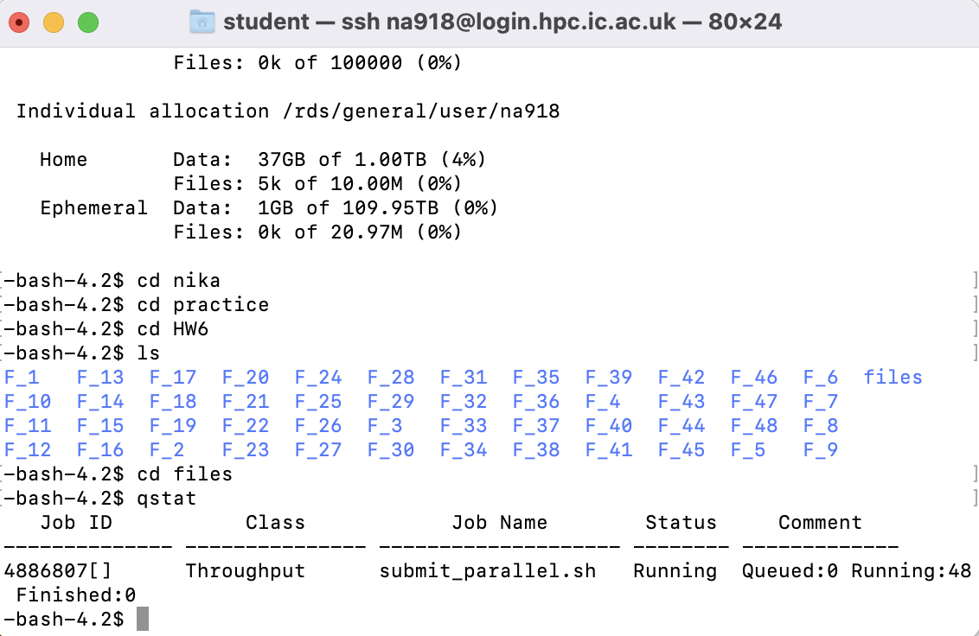
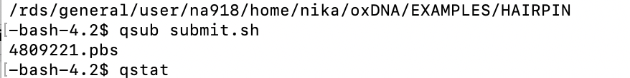
Step 2: Get familiar with ‘the cluster’

Slide 5
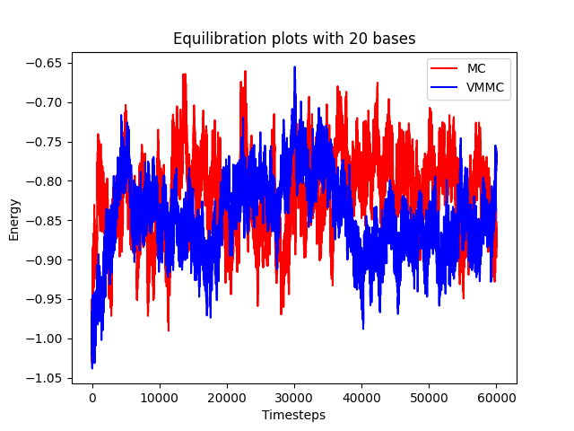
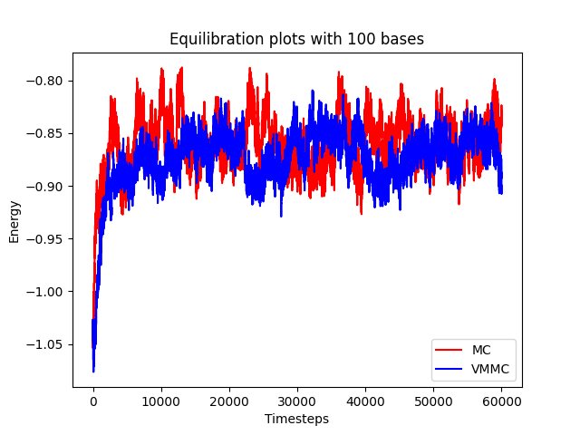
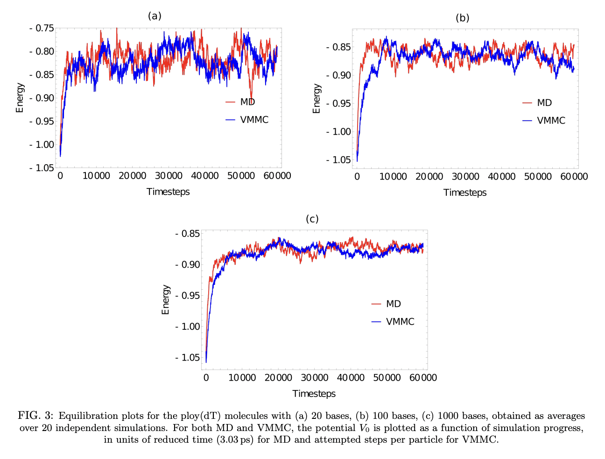
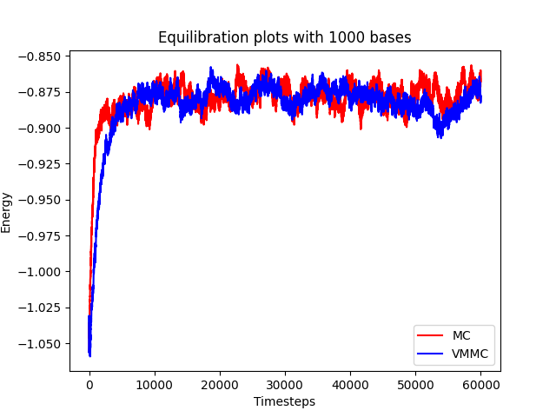
What practical experiments I’ve done: (or copied from Aditya)

Slide 6
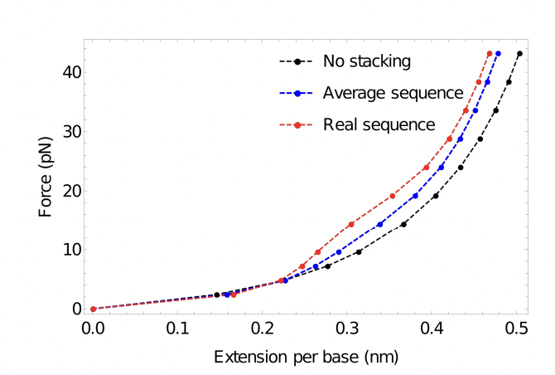
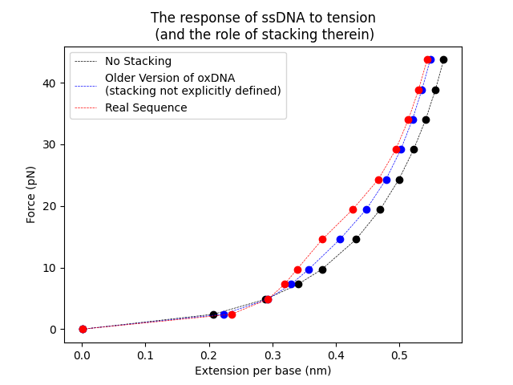
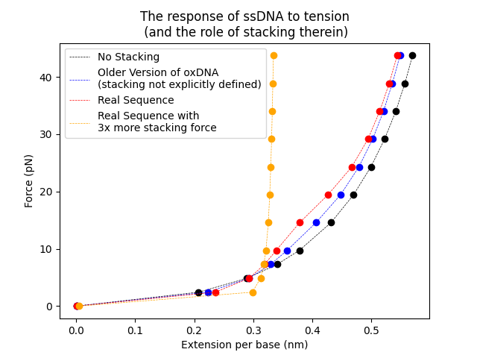
What practical experiments I’ve done: (or copied from Aditya)

Slide 7
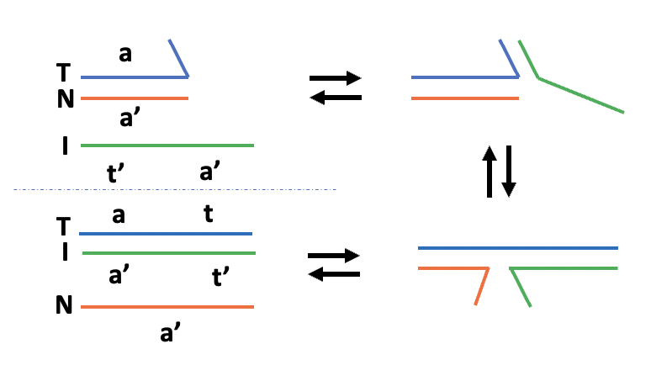
The theory behind my project:
TMSD
Copying by HMSD
a
T
Handhold (h)
N
Toehold Binding
a’
a
h’
a
h’
Handhold Binding
T
T
+
N
N
a’
a’
t’
a’
h’
h
I
t’
Branch Migration
t
a’
a
h
Handhold Detachment
h’
+
N
h’
I
T
a’
N
a’

Slide 8
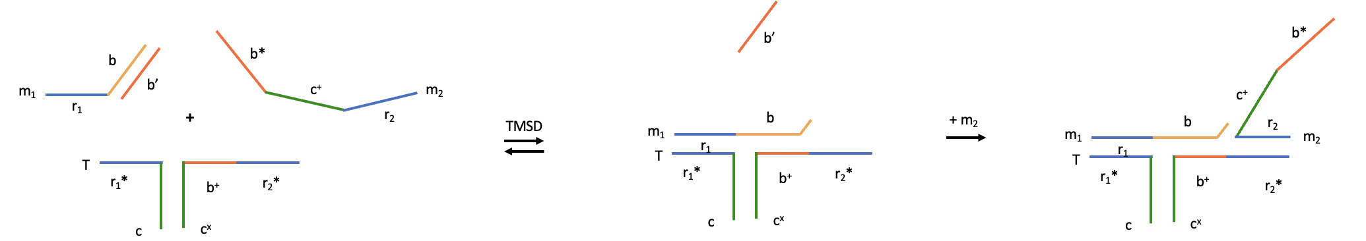
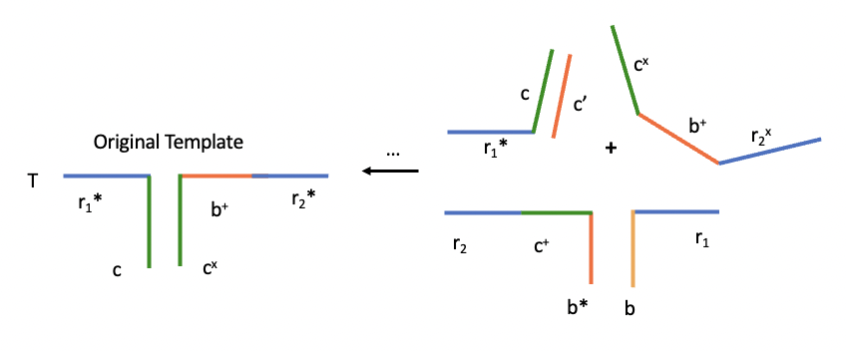
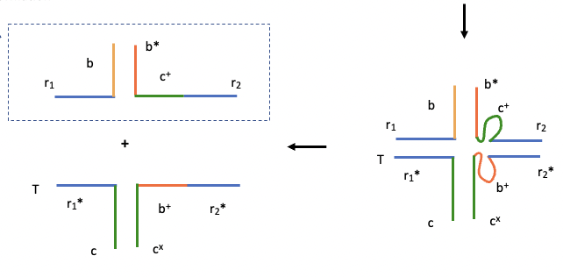
The theory behind my project:
TMSD
Replication by HMSD
Product can act as template for formation of template

Slide 9
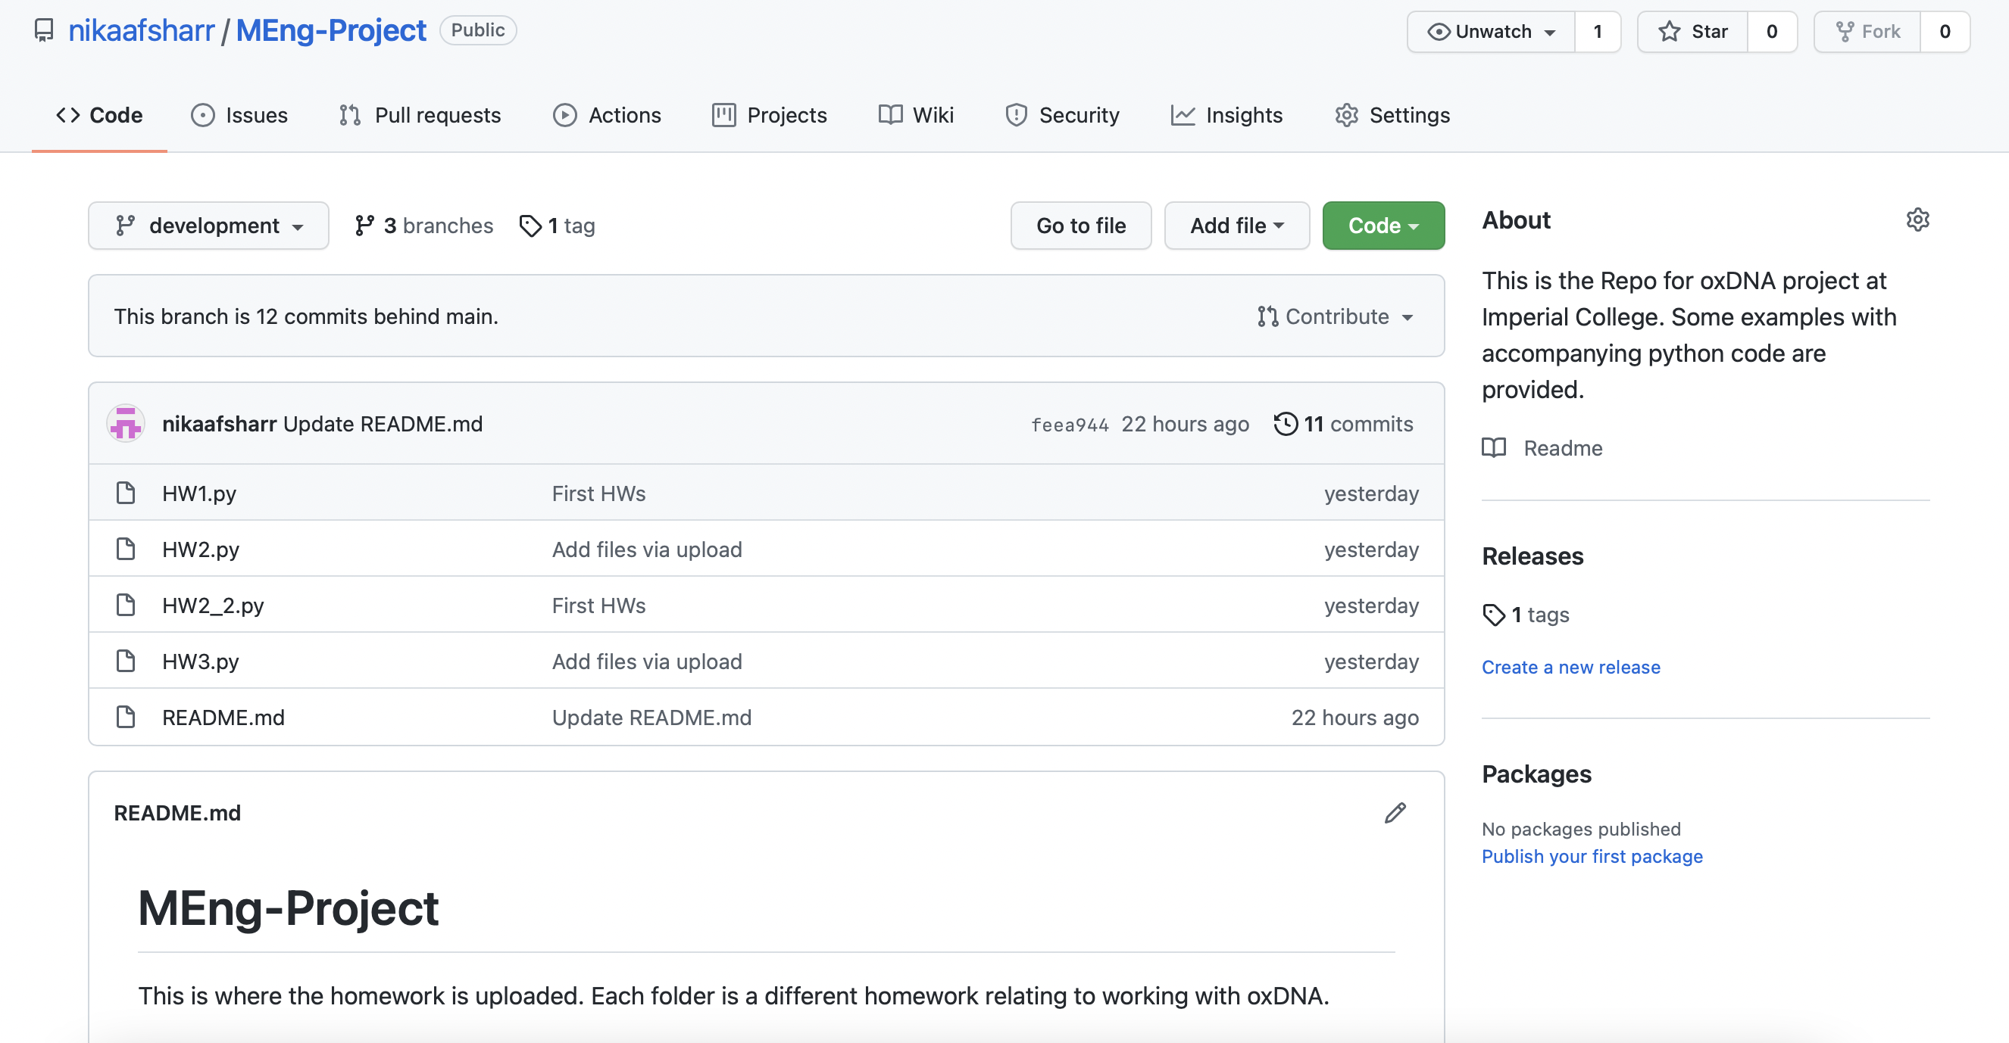
For future students (and if you want to also have a go):

Slide 10
That’s all!
Thank you for listening ☺

